Slide 1
Insurance Analytics
Team Members
Donkeshwar Badrinath | Nabeel Mohammed | Harinath | Avinesh Kumar | Faizan | Basheer | Sadanand
Power BI | Excel | Tableau | SQL

Slide 2
Problem Statement
The organization lacked a unified, real-time view to monitor and compare branch-level and individual performance across different business lines (New, Cross-Sell, and Renewal).
Decision-makers faced heavy roadblocks due to fragmented data scattered across Excel sheets and CRM databases, making it difficult to track sales pipelines, align targets with actual achievements, or identify performance bottlenecks.
This lack of visibility caused delayed reporting, misaligned goals, and lost opportunities for strategic coaching and growth.

Slide 3
Project Summary
Developed an end-to-end insurance analytics solution utilizing Excel, SQL databases, Tableau, and Power BI to centralize diverse data sources like brokerage records, fees, meetings, invoices, and CRM opportunities.
Enabled comprehensive tracking of 35 core KPIs spanning performance, pipelines, activities, billing, and policy health to drive accountability and data-driven decision-making.
Empowered corporate teams and branch heads with interactive dashboards for real-time visibility into revenue targets, sales funnel efficiency, and customer segment profitability.

Slide 4
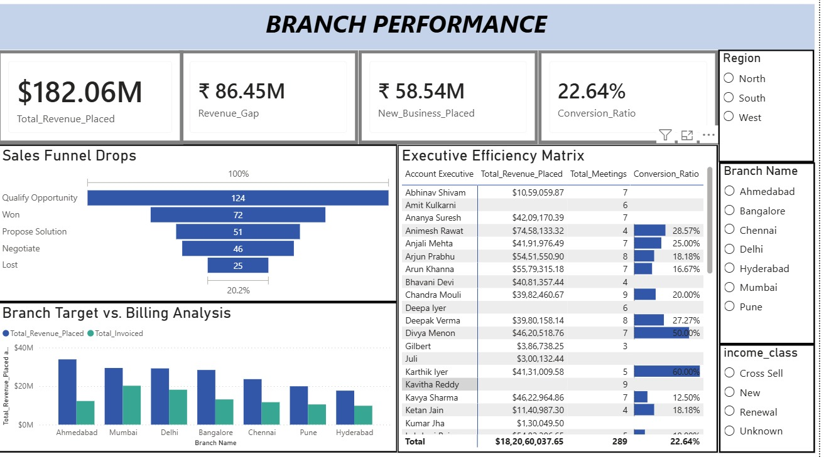
Power BI – Dashboard

Slide 5
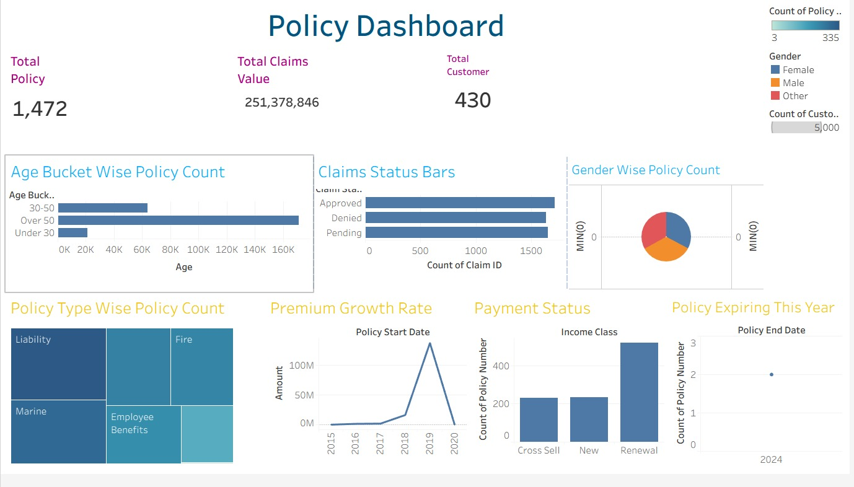
Tableau – Dashboard

Slide 6
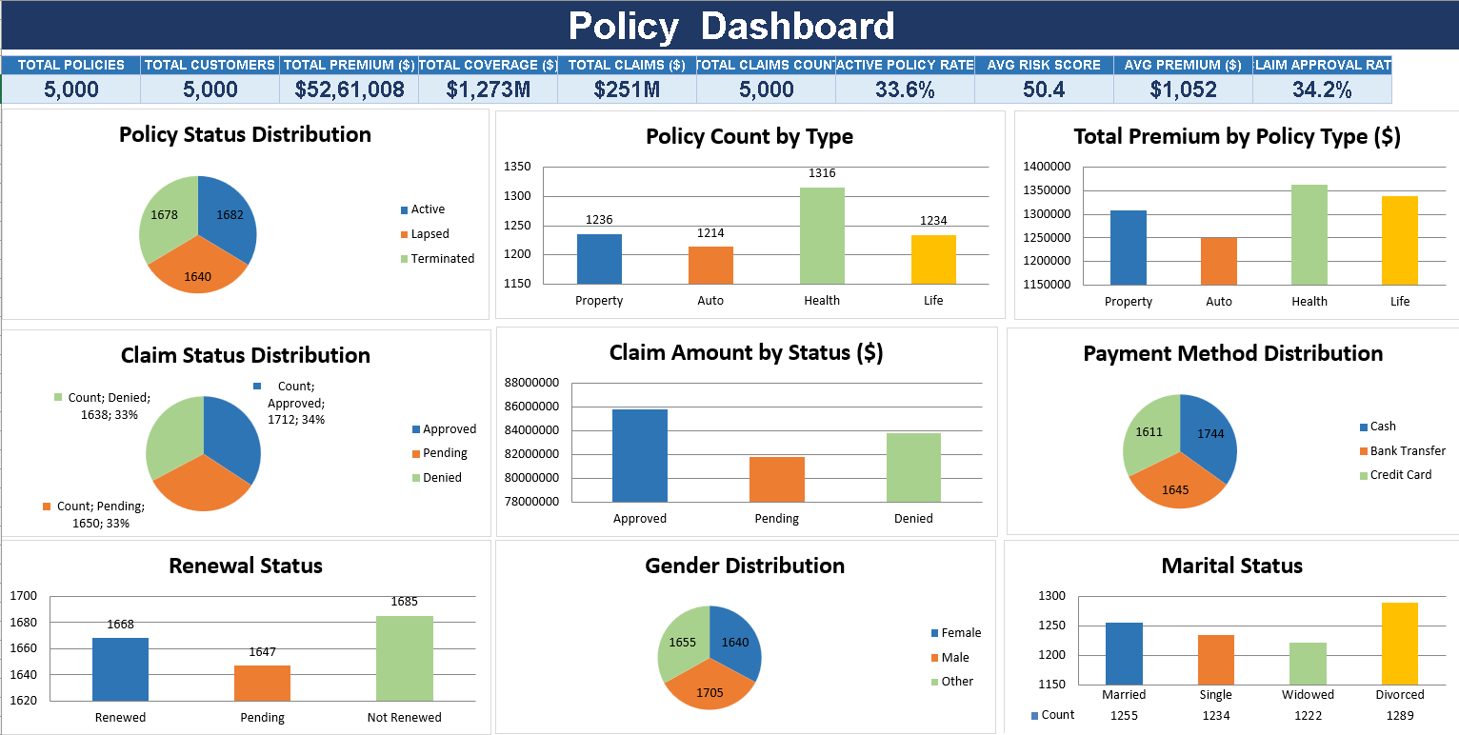
EXCEL – Dashboard

Slide 7
SQL — KPI Queries
-- 1 Total Policy
-- 2 Total Customers
-- 3 Age Bucket Wise Policy Count
SELECT COUNT(policy_number) AS Total_Policies FROM dim_policy;
SELECT COUNT(DISTINCT client_name) AS Total_Customers FROM dim_policy;
SELECT CASE WHEN Age < 30 THEN 'Under 30' WHEN Age BETWEEN 30 AND 50 THEN '30-50' ELSE 'Over 50' END AS Age_Bucket, COUNT(Customer ID) AS Customer_CountFROM customer informationGROUP BY CASE WHEN Age < 30 THEN 'Under 30' WHEN Age BETWEEN 30 AND 50 THEN '30-50' ELSE 'Over 50' END;
-- 4 Gender Wise Policy Count
-- 5 Policy Type Wise Policy Count
-- 6 Policy Expiring This Year
SELECT Gender, COUNT(Customer ID) AS Customer_CountFROM customer informationGROUP BY Gender;
SELECT product_group AS Policy_Type, COUNT(policy_number) AS Policy_CountFROM dim_policyGROUP BY product_group;
SELECT COUNT(policy_number) AS Policies_Expiring_2024FROM dim_policyWHERE YEAR(policy_end_date) = 2024;

Slide 8
SQL — KPI Queries
-- 7 Premium Growth Rate
-- 8 Claim Status Wise Policy Count
-- 9 Payment Status Wise Policy Count
SELECT YEAR(policy_start_date) AS Financial_Year, SUM(Amount) AS Total_PremiumFROM brokerageGROUP BY YEAR(policy_start_date)ORDER BY Financial_Year;
SELECT Claim Status, COUNT(DISTINCT Policy ID) AS Policy_CountFROM claimsGROUP BY Claim Status;
SELECT income_class AS Payment_Status, COUNT(DISTINCT policy_number) AS Policy_CountFROM invoiceGROUP BY income_class;
-- 10 Total Claim Amount
SELECT SUM(Claim Amount) AS Total_Claim_PayoutFROM claims;

Slide 9
Key Findings
Key Findings
Target Achievement Gaps: Performance metrics showed distinct variances across business lines, revealing where teams hit targets and where cash flow risks (such as the placed-vs-invoiced gap) occurred.
Sales Pipeline Efficiency: Funnel analysis highlighted major revenue drop-offs between the initial qualification stages and final negotiations, pinpointing where deals stall.
Client & Segment Concentration: Customer analytics demonstrated that specific client segments and industries drive the majority of the book of business, guiding where future sales efforts should focus.
Activity-to-Revenue Impact: Tracking meeting counts and engagement metrics against closed wins revealed how client interaction frequency directly correlates with individual deal success.

